Slide 1
Mathematical Models for Multiubiquitination and Polyubiquitination Processes
Guy Needham

Slide 2
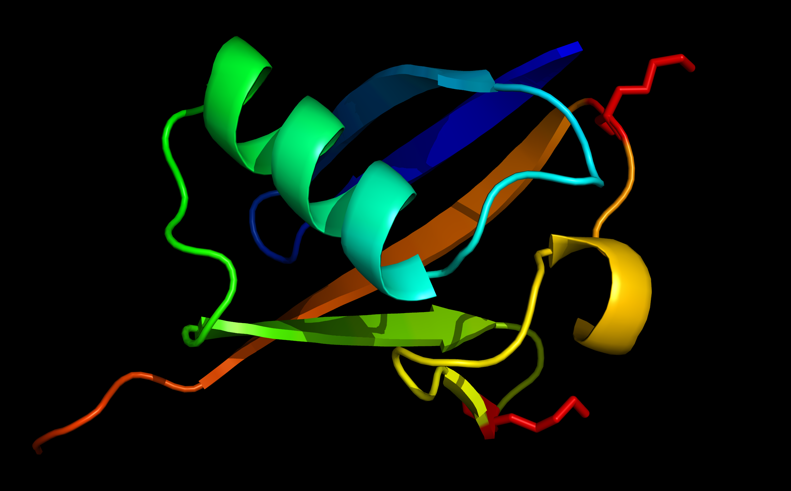
Biological Motivation
A ubiquitin monomer with lysine resides 48 and 63 highlighted.

Slide 3
Project Aims
Present novel mathematical models for ubiquitination processes.
Compare processive and distributive polyubiquitination.
Interpret the models to increase our knowledge of ubiquitination.

Slide 4
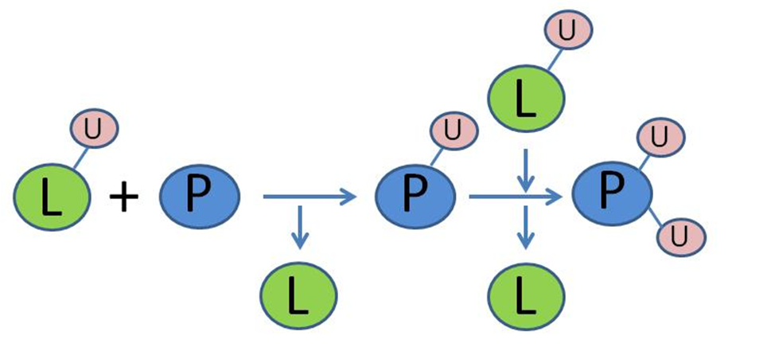
Multiubiquitination
Cartoon representation of multiubiquitination.

Slide 5
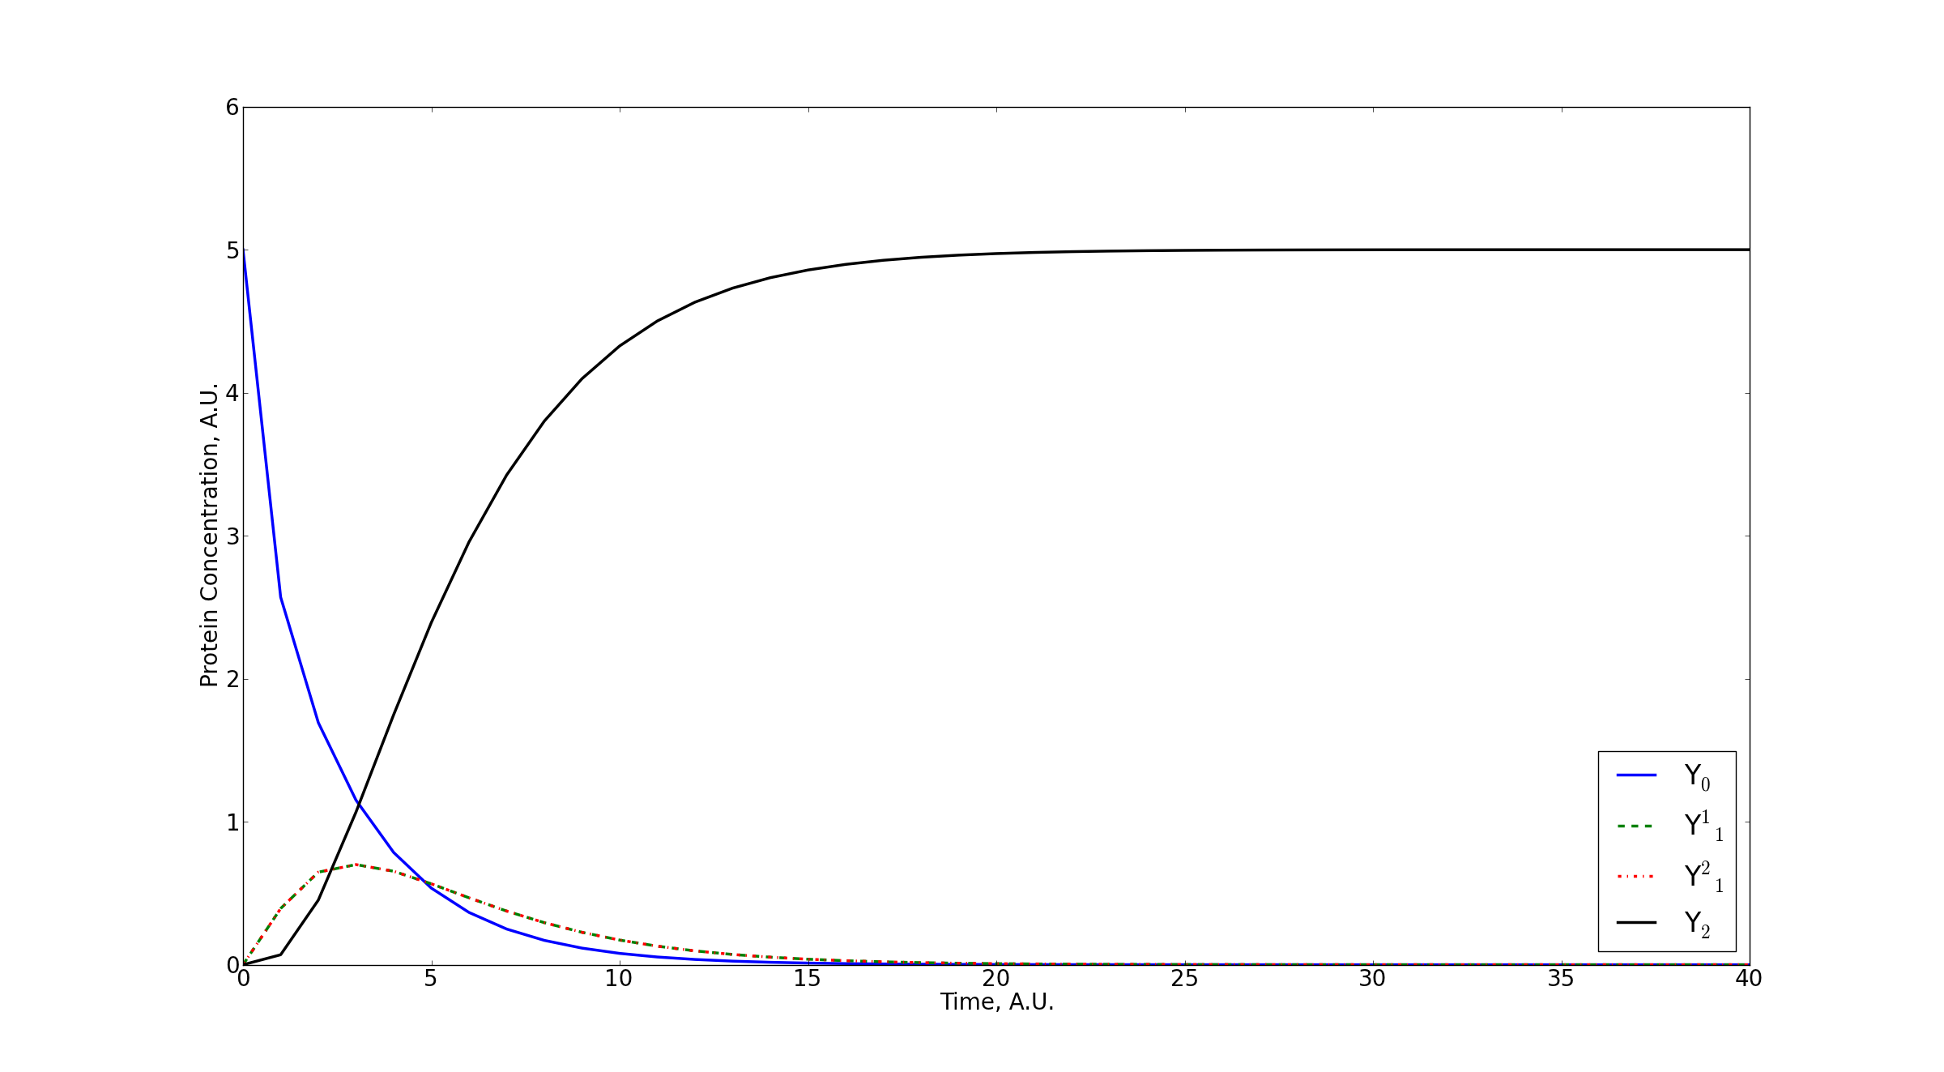
Multiubiquitination
Numerical evaluation of a mathematical model of multiubiquitination.

Slide 6
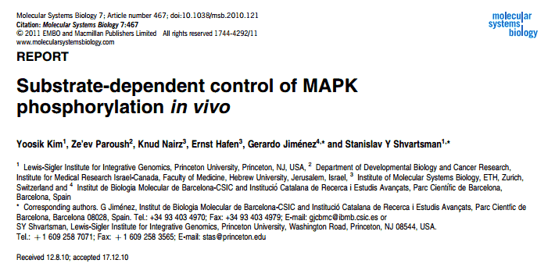
Retroactivity
Retroactivity discovered in 2010:
Increase in MAPK substrate increases activity of MAPK;
Decrease in MAPK substrate decreases activity of MAPK;
Termed retroactivity;
Suspected to be present in many covalent modification processes.

Slide 7

Multiubiquitination and Retroactivity
Protein a
Protein b
k₂
k₁
Signal +
L
L
L
L
L
k₄
k₃
Signal -
Future perspectives – retroactivity in multiubiquitination:
Increase in conformer a increases k₁;
Leads to increase in signal;
Implementing retroactivity in model could be interesting.

Slide 8
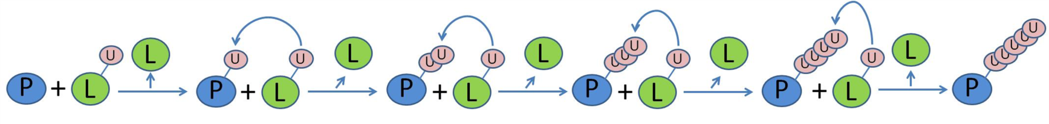
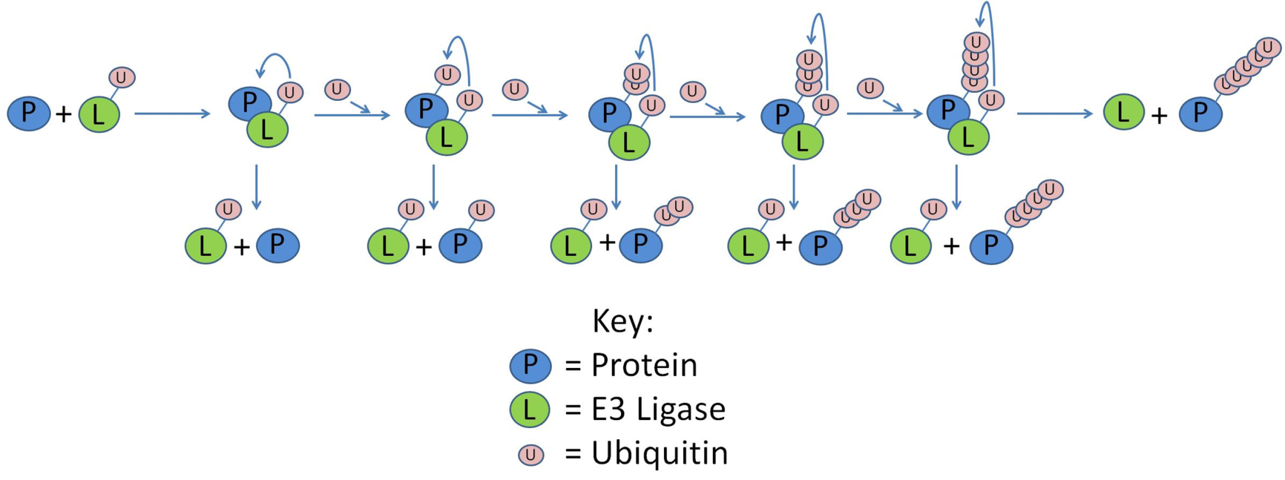
Polyubiquitination
Distributive polyubiquitination:
Processive polyubiquitination:
Cartoon representations of polyubiquitination.

Slide 9
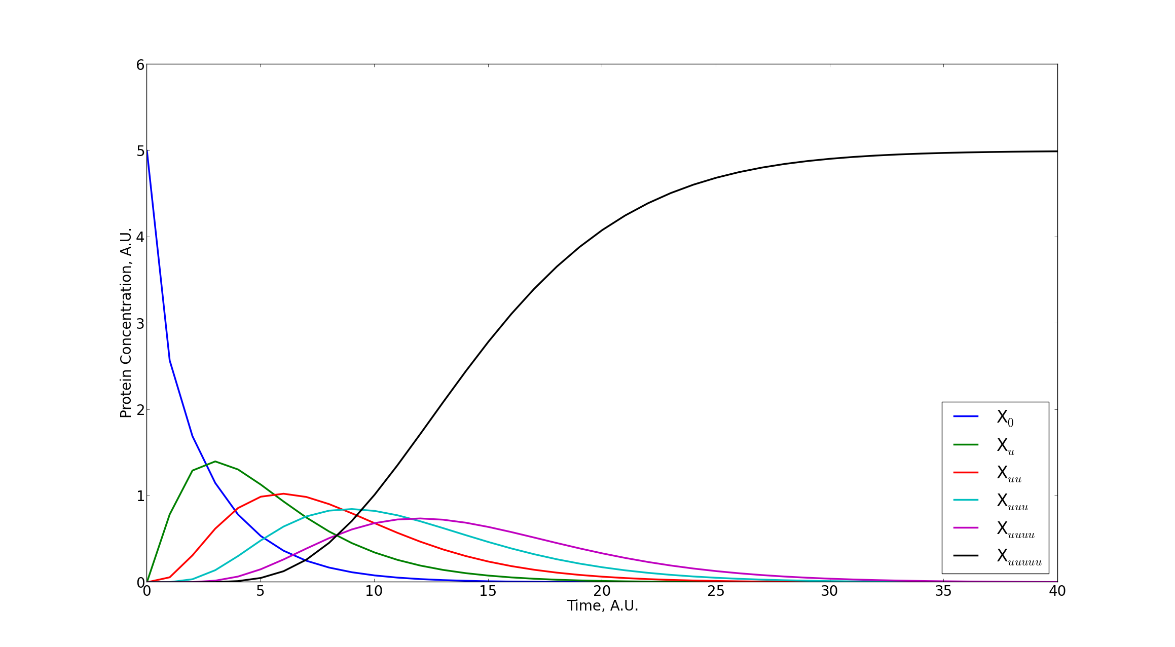
Distributive Polyubiquitination
Numerical evaluation of a model of distributive polyubiquitination.

Slide 10
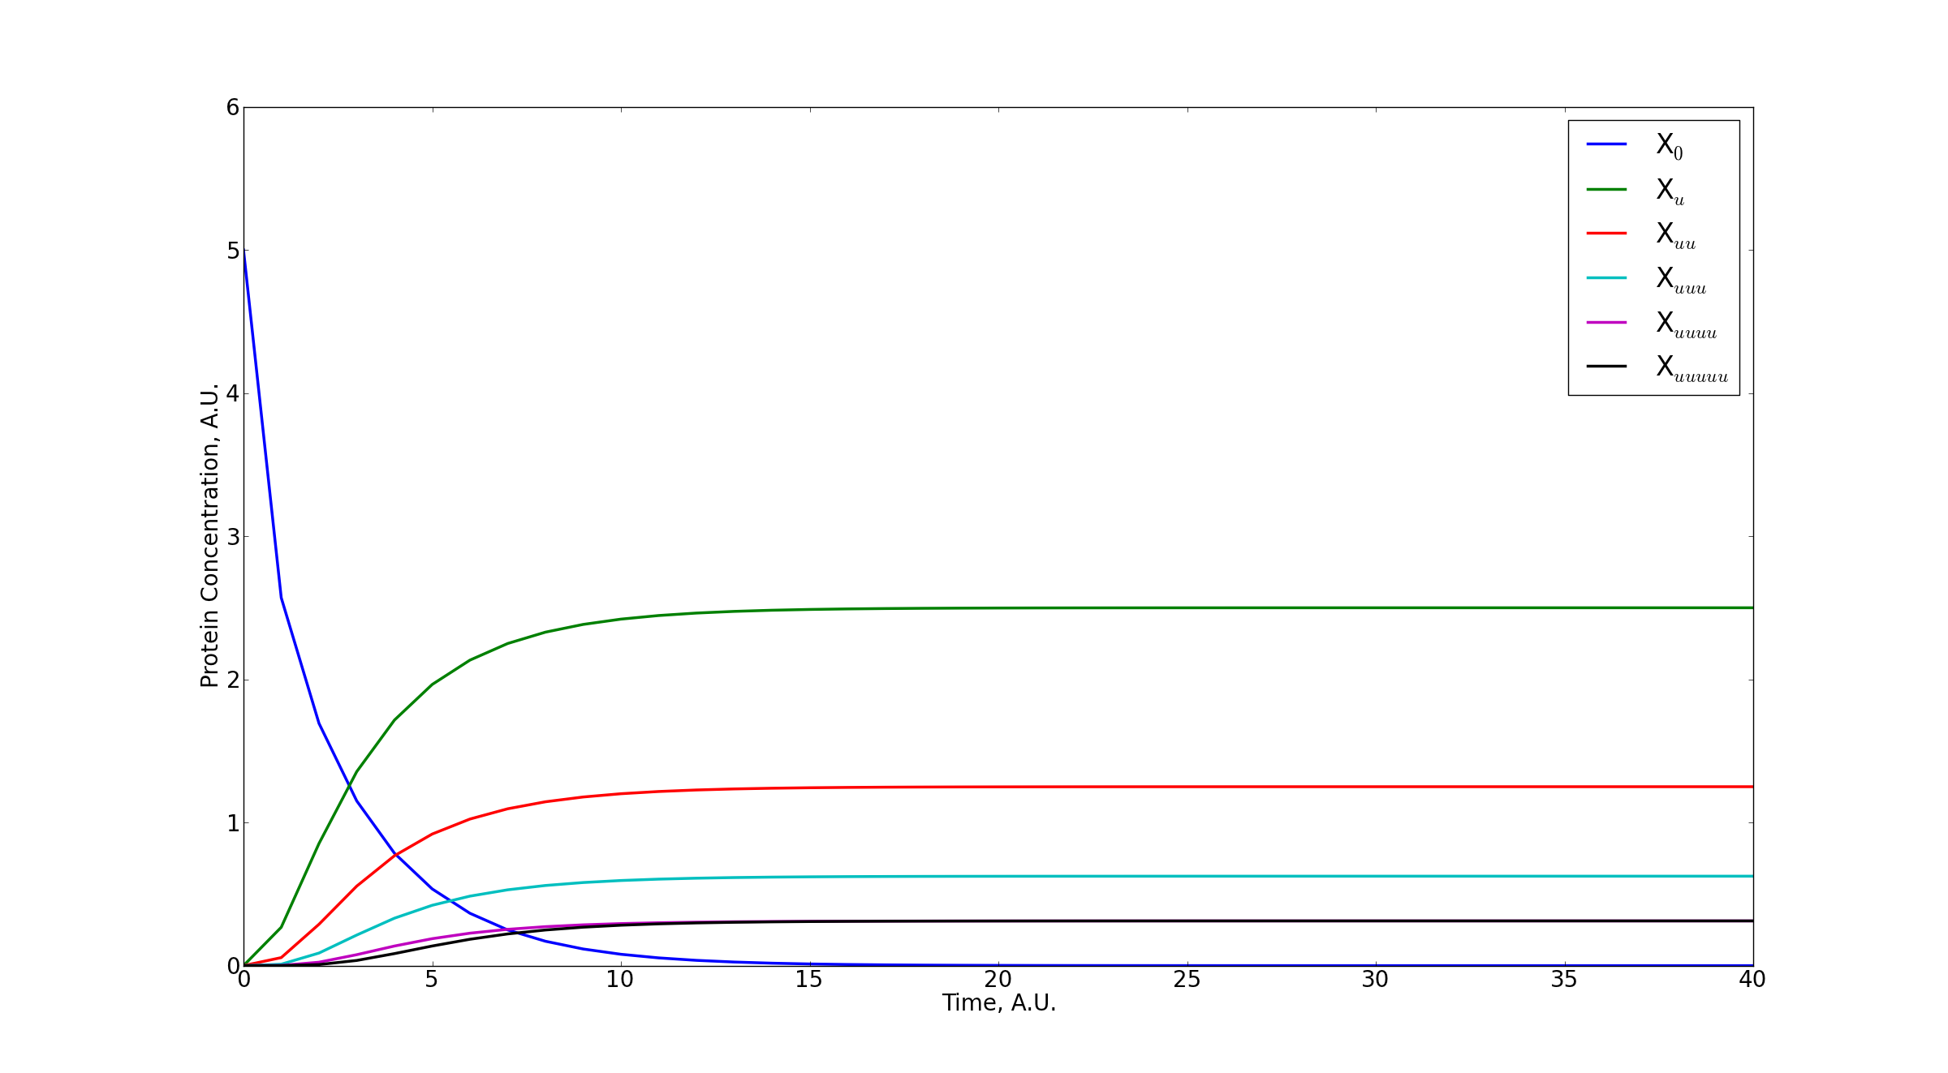
Processive Polyubiquitination
Numerical evaluation of a model of distributive polyubiquitination.

Slide 11
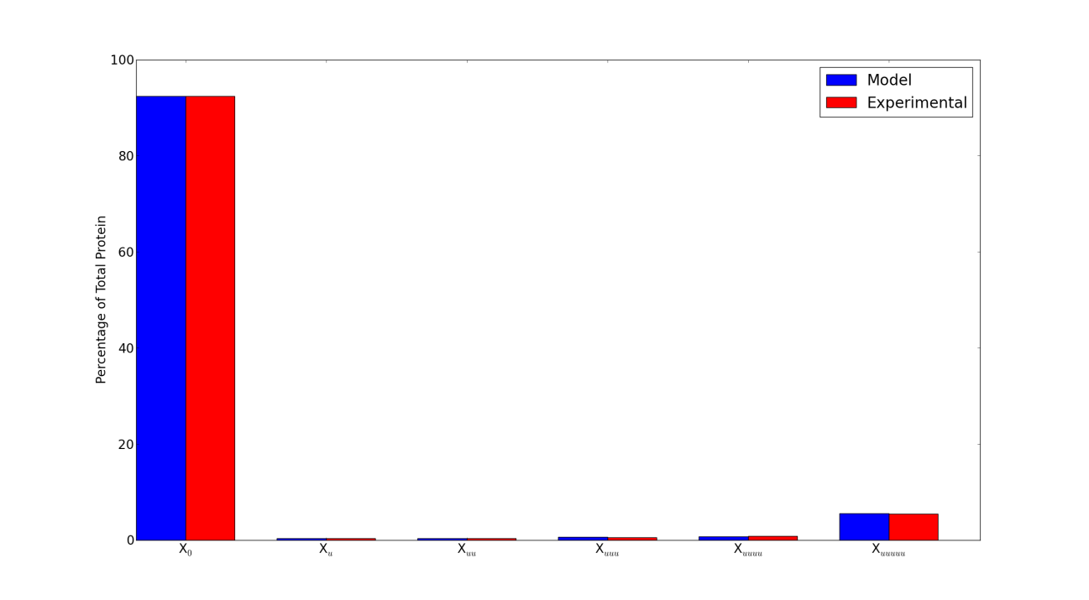
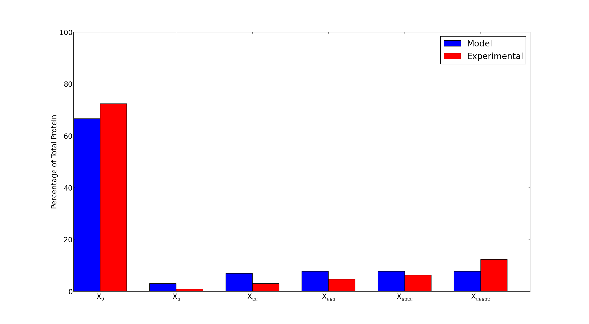
Processive Polyubiquitination
β-Cat
CYCE
Comparison of numerically solved models of processive polyubiquitination to experimentally derived values.

Slide 12
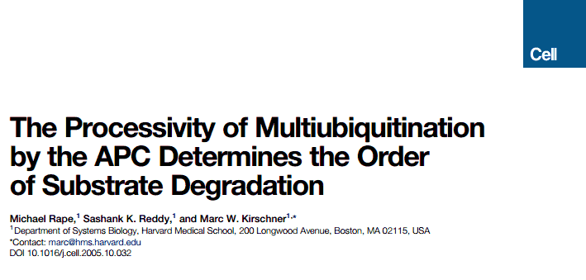
Processivity
Substrates have different levels of processivity:
Some more distributive;
Some more processive;
Processivity determines substrate ordering;
More processive substrates outcompete others, are ubiquitinated more rapidly.

Slide 13
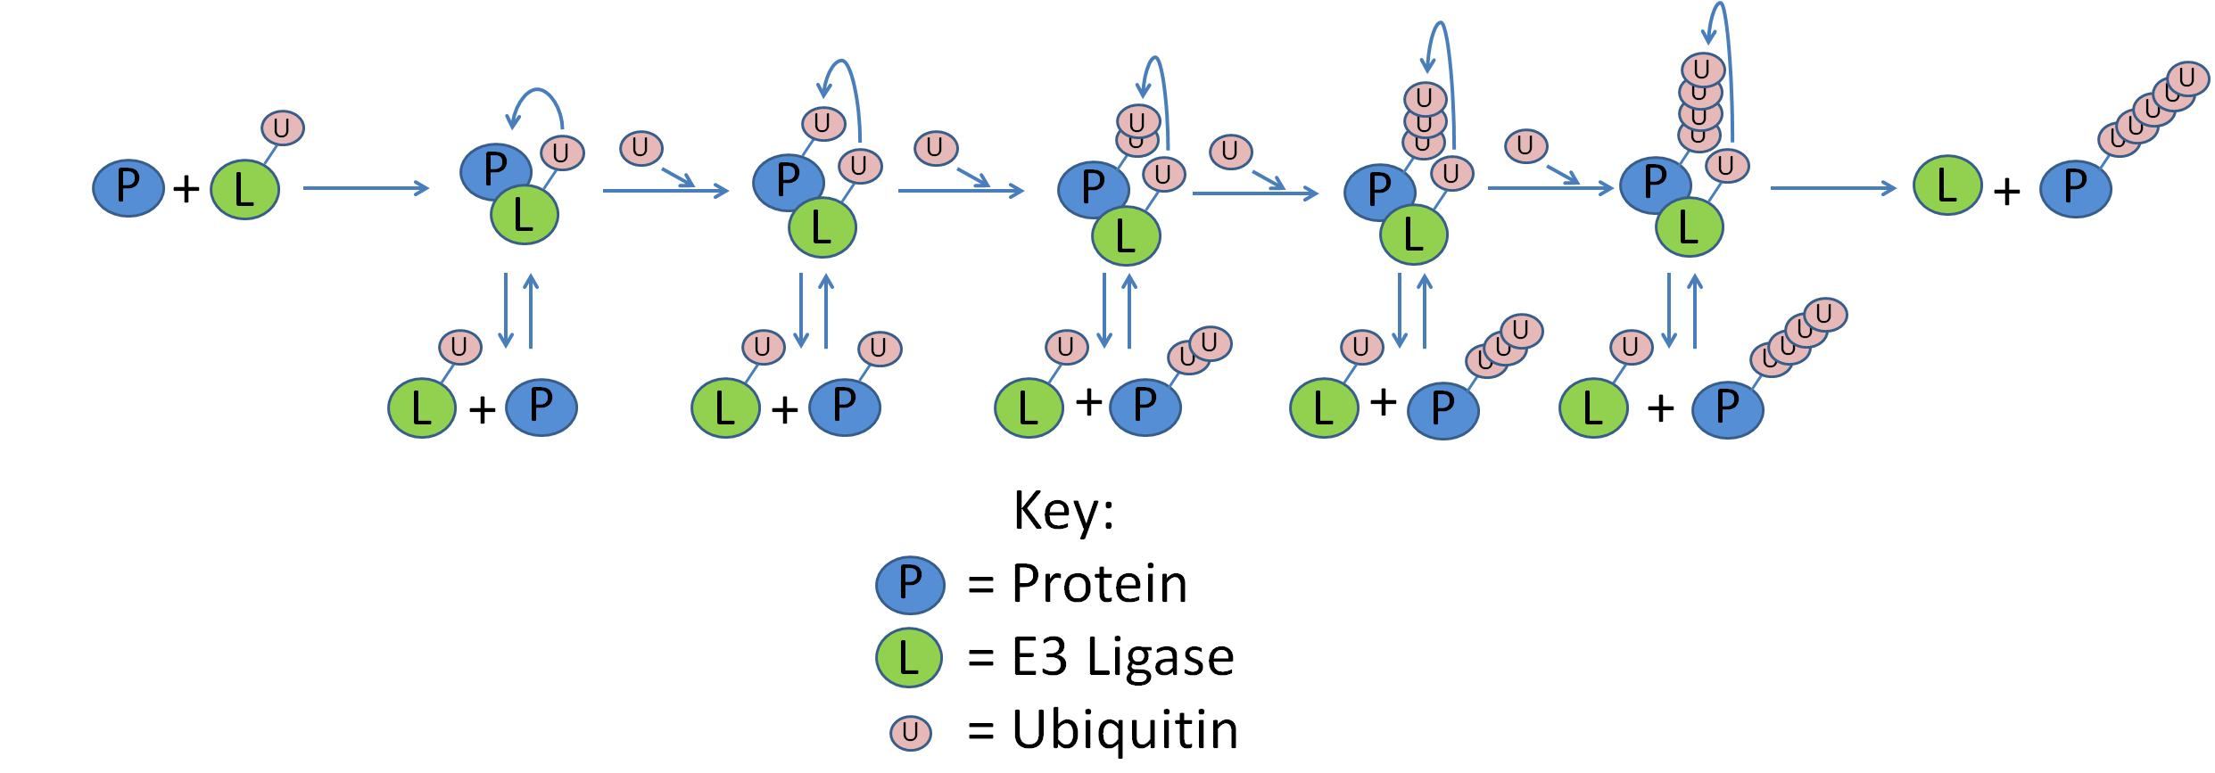
Unified Model of Polyubiquitination
Cartoon representation of a mathematical model of a unified model of polyubiquitination.

Slide 14
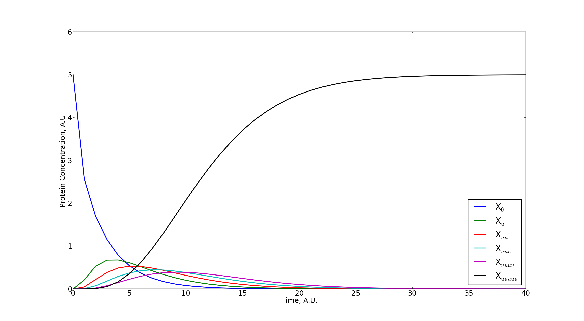
Unified Model of Polyubiquitination
Numerical evaluation of a unified model of polyubiquitination.

Slide 15
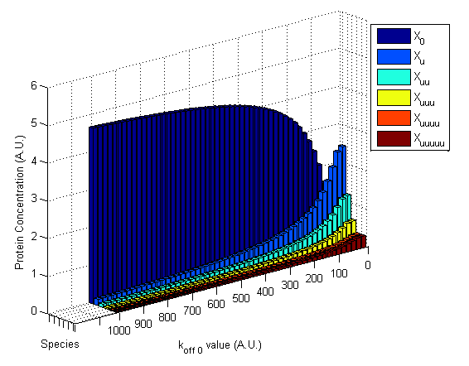
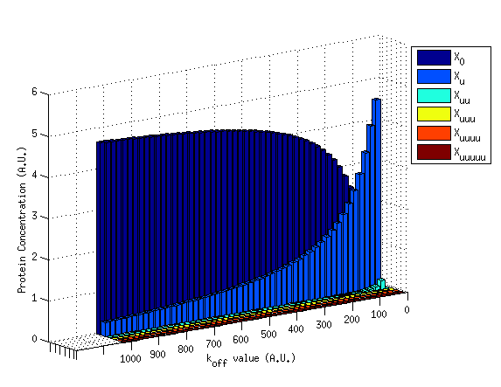
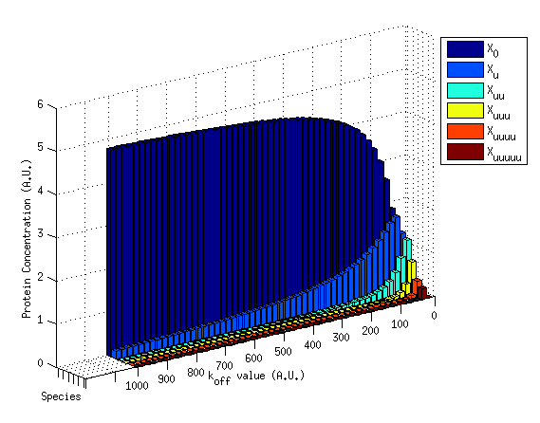
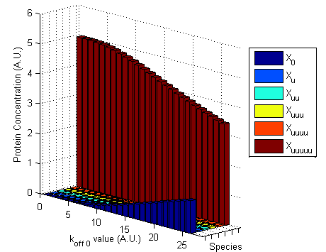
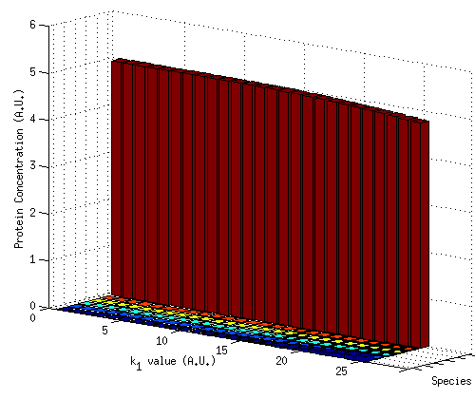
Sampling Dissociation Constants
Unified
Processive
Processive
Unified
Distributive
Key:
The unified model represents both extremes of the scale of processivity.

Slide 16
Polyubiquitination – Future Perspectives
Scale of processivity:
Distributive
Processive
0
1
Polyubiquitination occurs on a sliding scale of processivity.
Investigate how rate constants determine processivity.
What rate constants and their resultant protein concentrations typify points on scale of processivity?
How does the concentration of the ligase affect simulation results?

Slide 17
Polyubiquitination – prediction tool
Input option 1: protein concentrations from experiment.
Input option 2: rate constants.
Prediction tool logic:
- Compare to library of concentrations generated by model;
- Find rate constants.
Evaluate model.
Output: protein concentrations:
- graphical representation;
- automate Western blot simulation;
- compare predictions to results.

Slide 18
Conclusions
Presented models of multiubiquitination and polyubiquitination.
The unified model of polyubiquitination covers both extremes of a scale of processivity.
Further investigation of this model would yield interesting insights into how processivity is defined.
Rate constants could be predicted for experimental data.

Slide 19
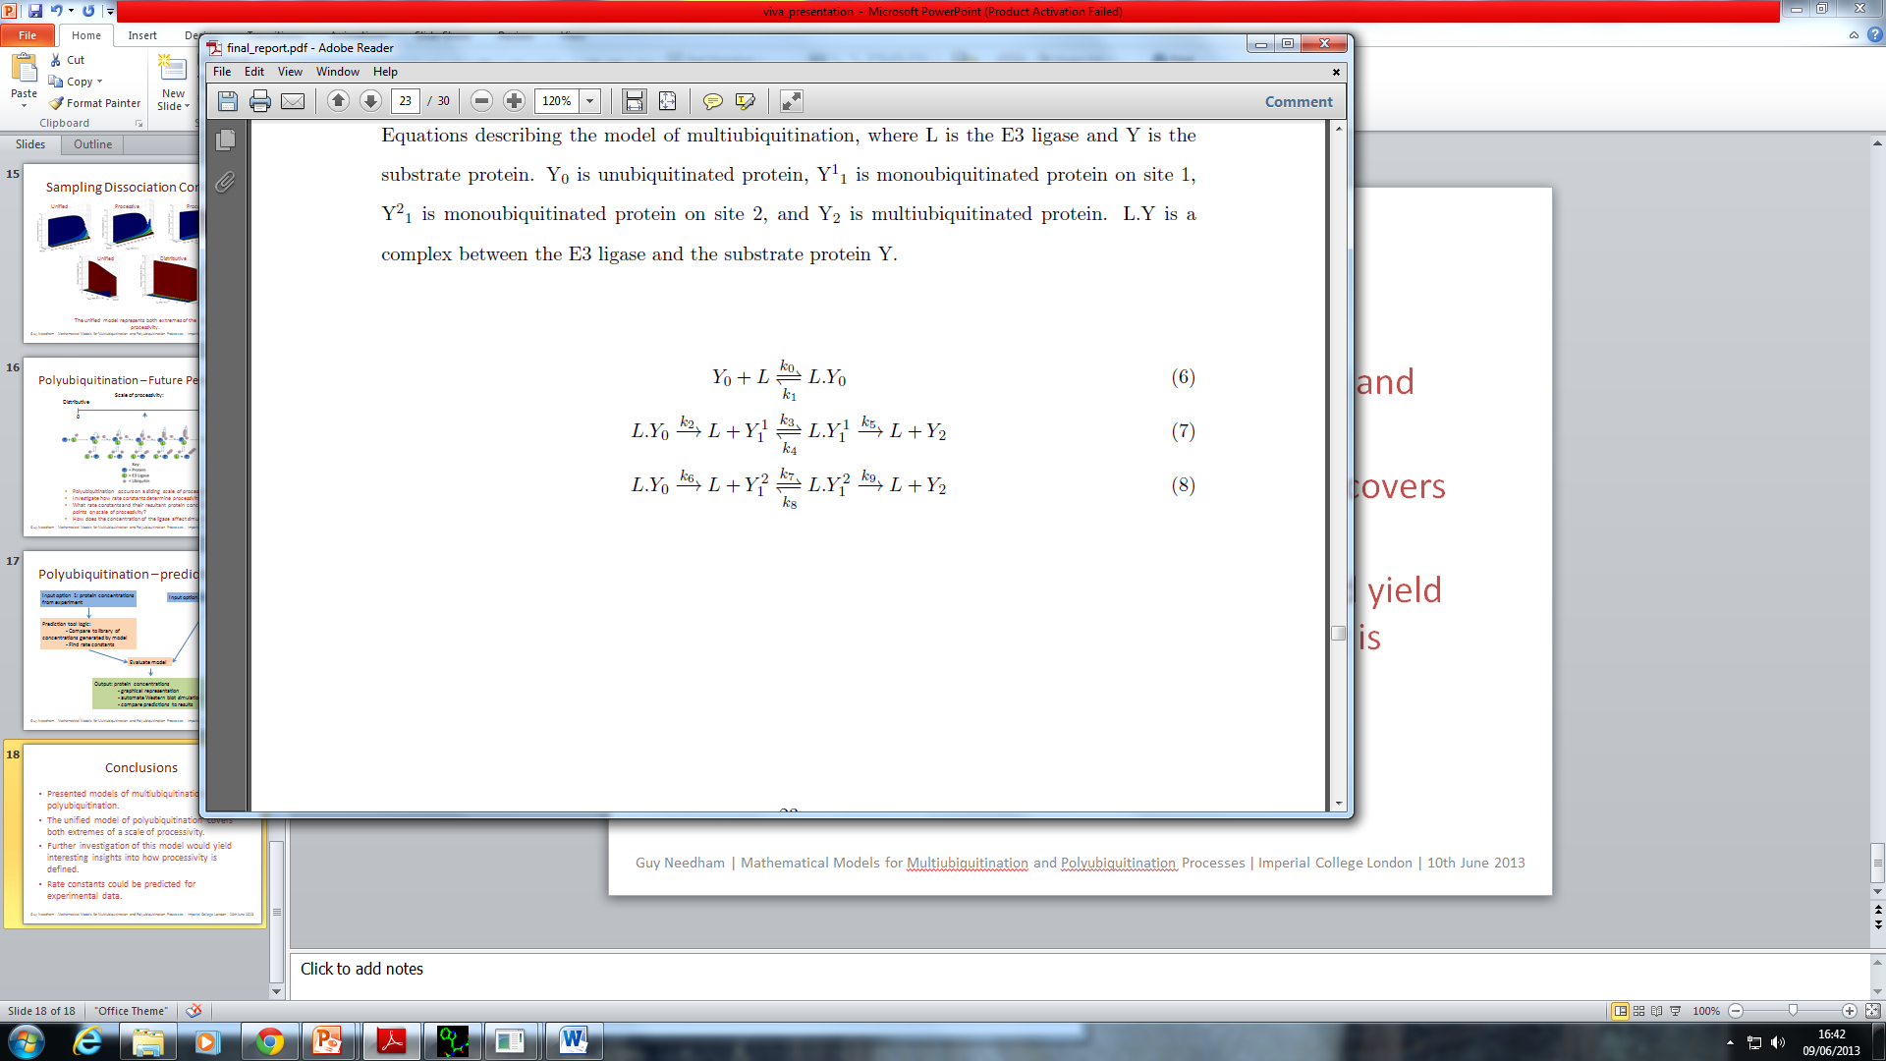
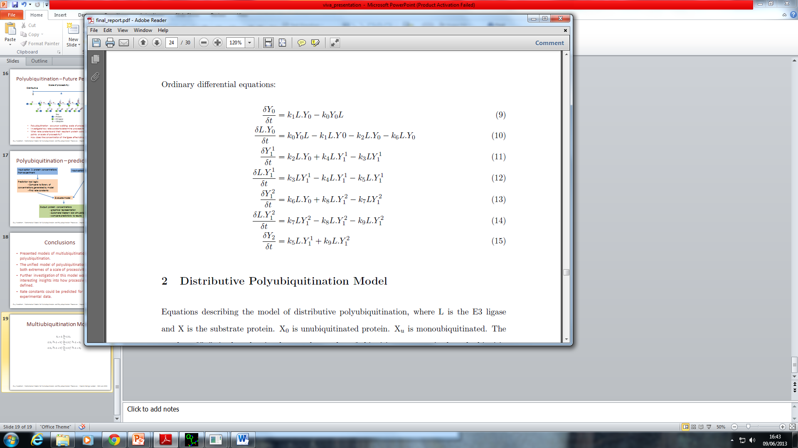
Multiubiquitination Model

Slide 20
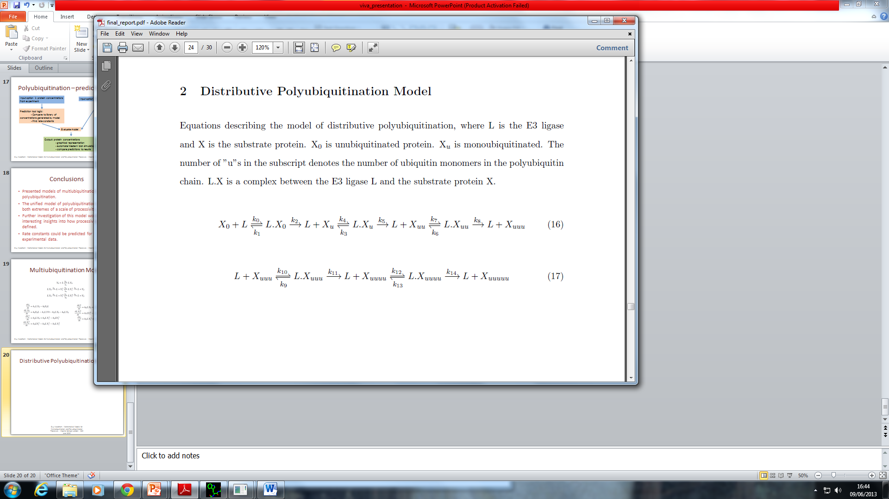
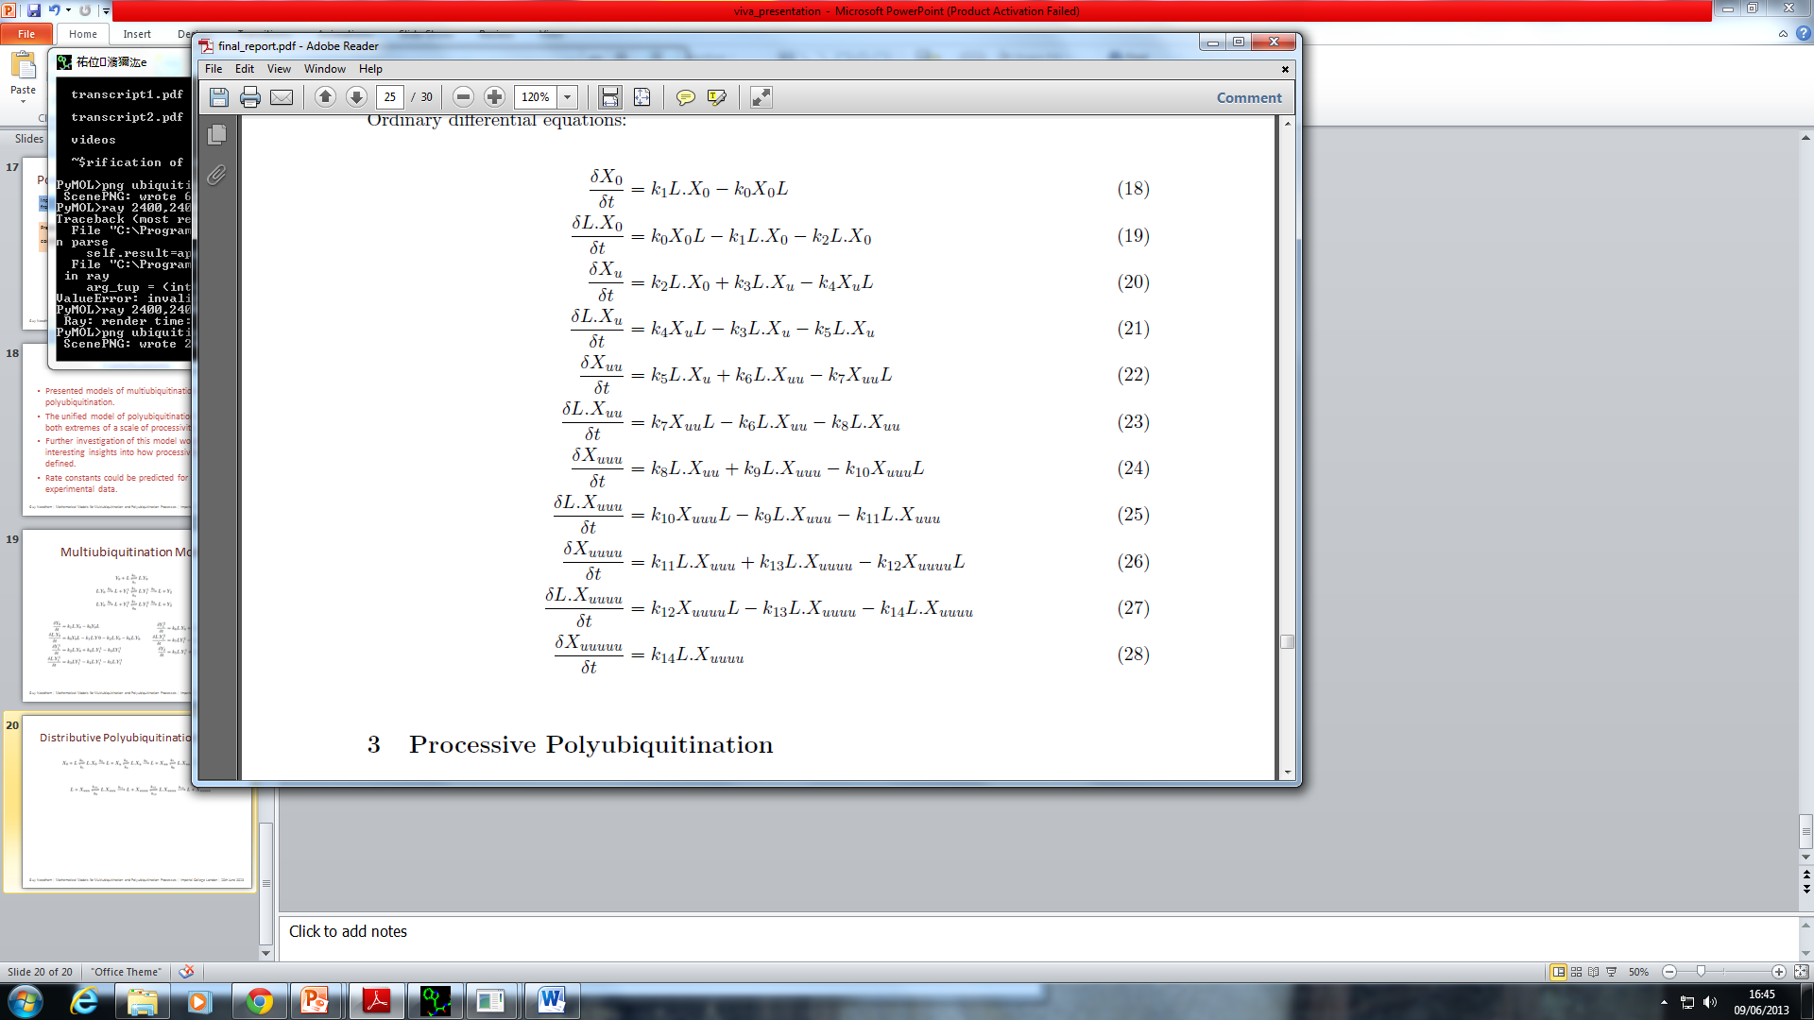
Distributive Polyubiquitination Model

Slide 21
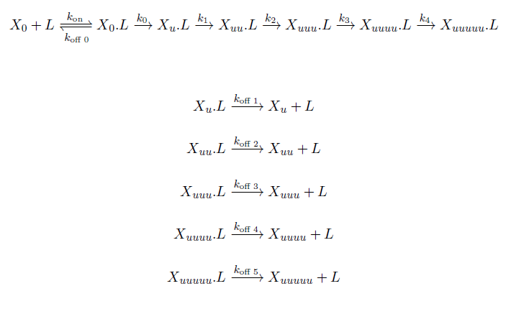
Processive Polyubiquitination Model (1)

Slide 22
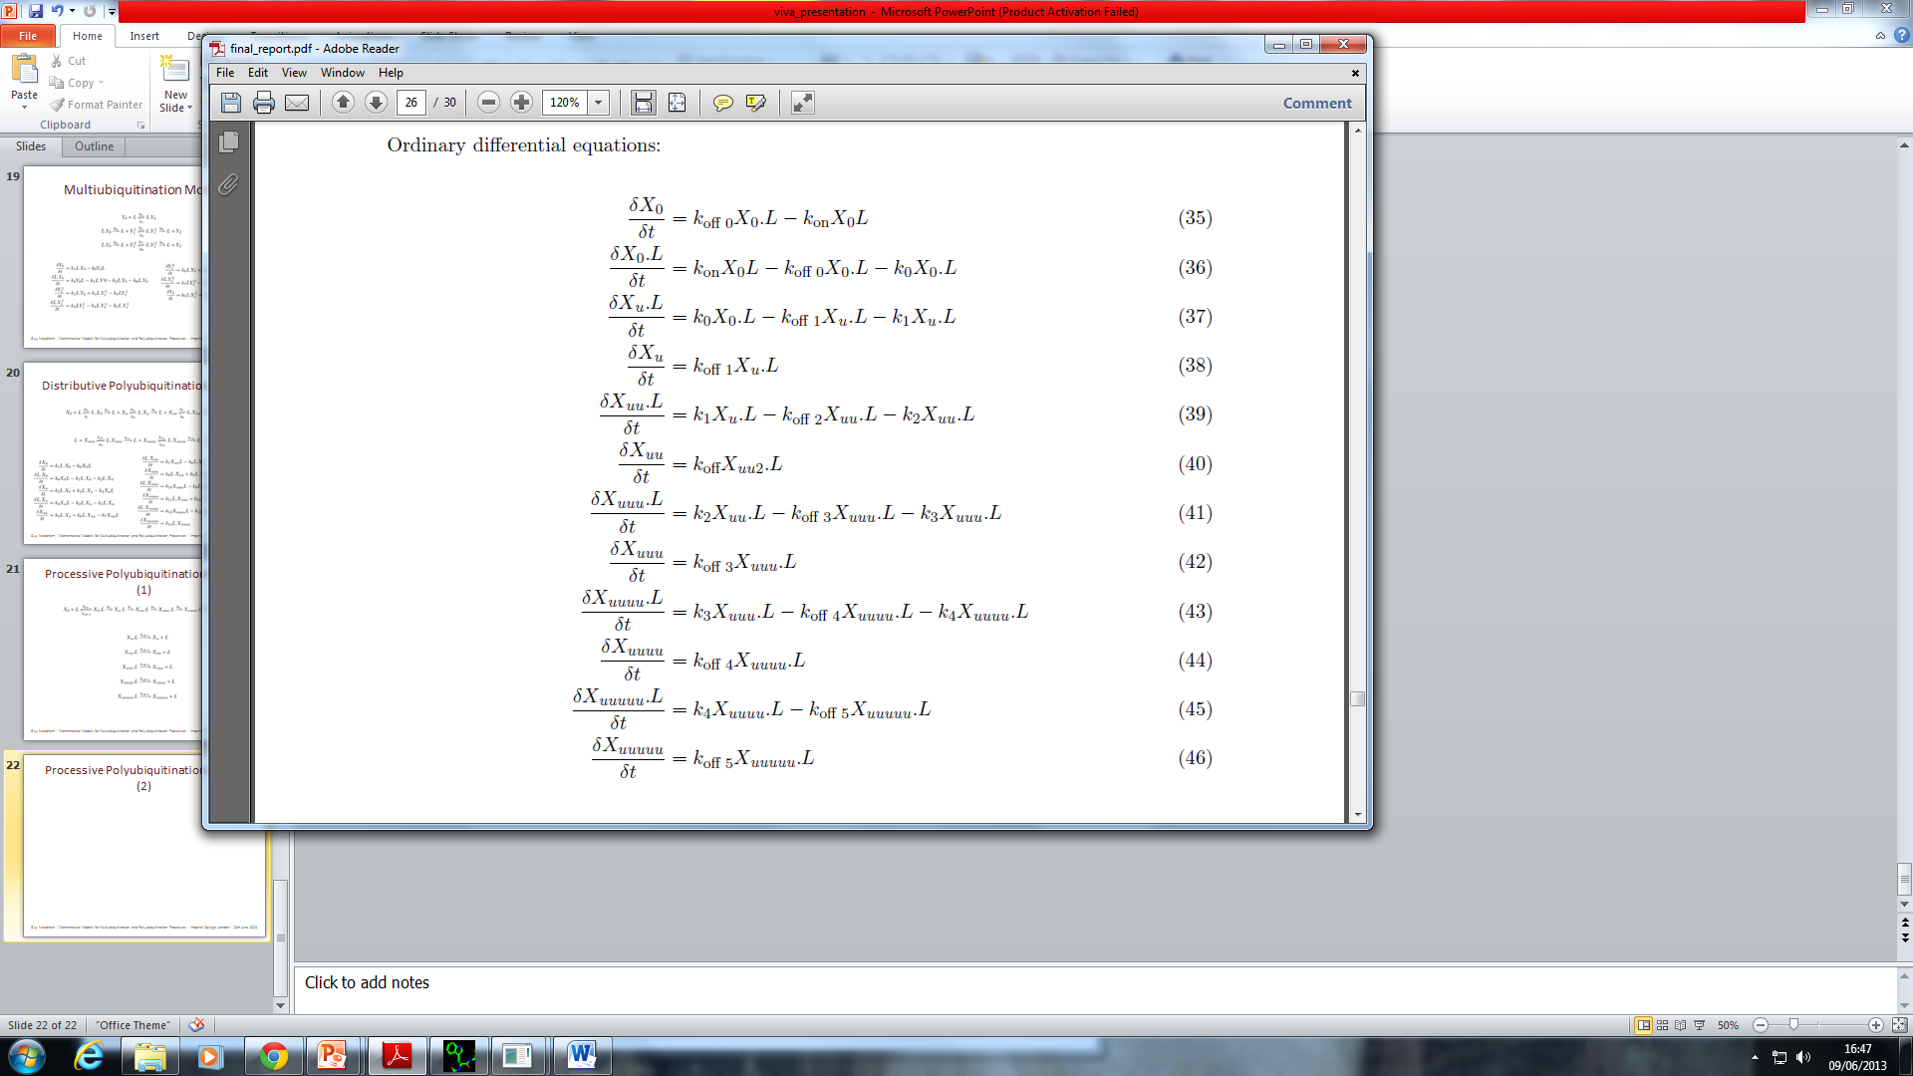
Processive Polyubiquitination Model (2)

Slide 23
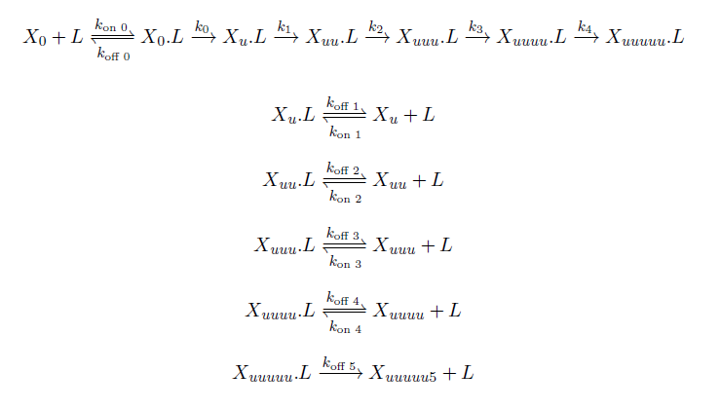
Unified Model of Polyubiquitination (1)

Slide 24

Unified Model of Polyubiquitination (2)

Slide 25
Unified Model of Polyubiquitination (3)

